Slide 1
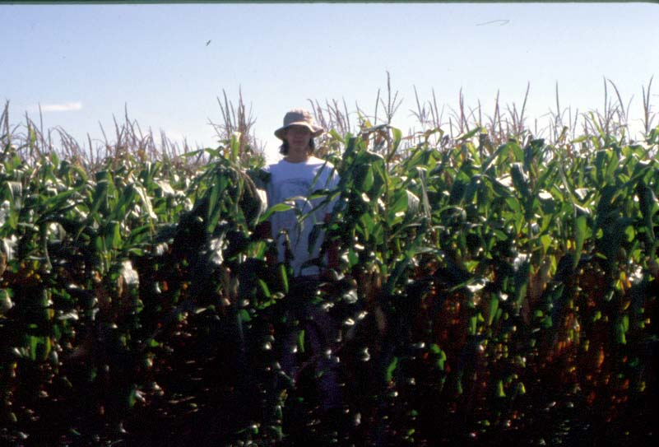
Nitrogen (N): Critical for life
As a component of amino acids, proteins and nucleic acids (DNA and RNA), N is required by all living things.
Plants, algae and bacteria mainly use two inorganic forms of nitrogen: ammonium (NH₄⁺) and nitrate (NO₃⁻). Animals can use only amino acids and proteins.
Did you ever wonder where most of the N in plants comes from naturally? And by what process?

Slide 2
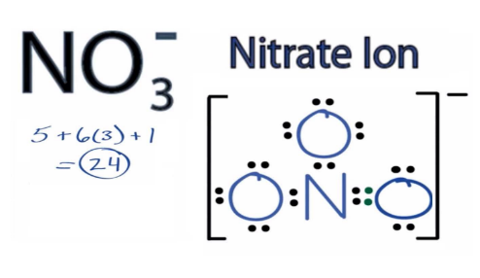
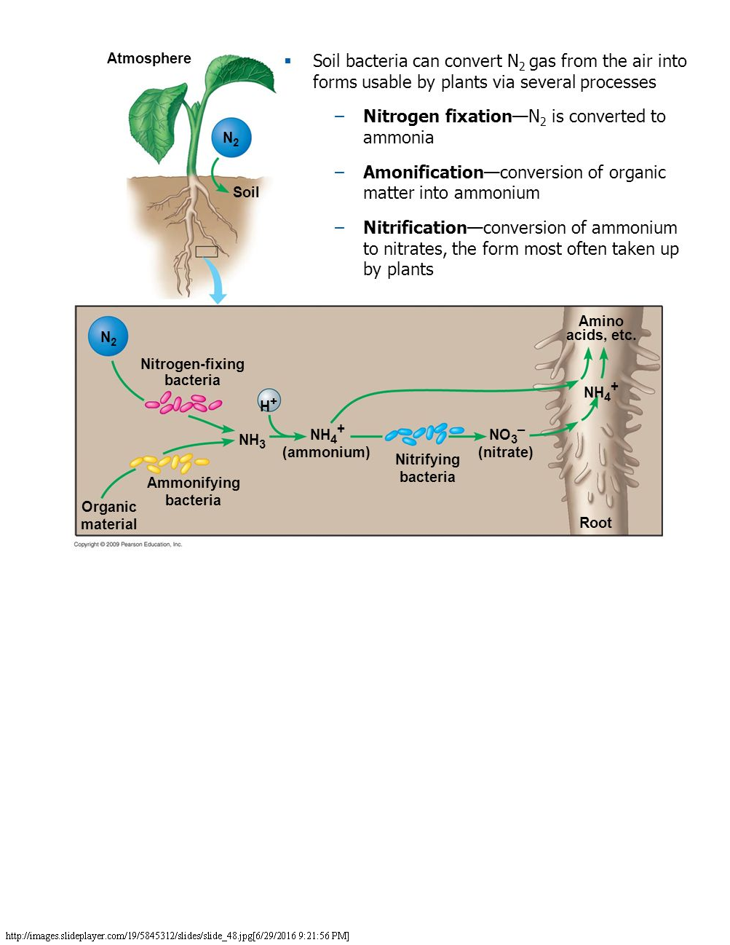
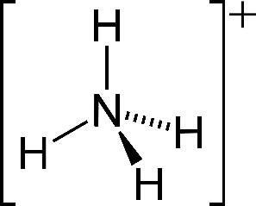
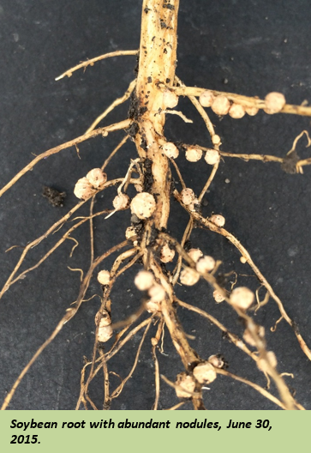
It comes from the air!
By the process of N fixation
Inorganic N
Inorganic N
Dinitrogen = N₂
Ammonium NH₄⁺
N
N
N fixation: Driven by
lightning or microbes
Nitrification: Driven by microbes
The atmosphere is 78% dinitrogen gas (N₂).
Some plant species (many legumes, such as soybean and alfalfa) host microbes that ‘fix’ N within root nodules, i.e., convert N₂ to NH3.
N₂ is not usable for plants; inorganic NH₄ and NO₃ are.
Notes:
Note: Free-living microbes can also fix N2, but generally at much lower rates than symbiotic N-fixing microbes.

Slide 3
Let’s follow N as it flows between Stocks (= reservoirs or pools) in an agricultural system
Atmosphere
N₂
Notes:
Within the farm landscape, nitrogen cycles among storages in the atmosphere, soil, crops, and streams.
Let’s trace the flows through the agricultural system, starting with the atmospheric stock.

Slide 4
Stocks and Flows in the N Cycle
Flow 1 = N fixation = conversion of N2
in the atmosphere to NH₃ or NH₄⁺.
N flows from the Atmosphere
to the Soil Inorganic N stock.
Atmosphere
N₂
1
Soil Inorganic N
Notes:
Nitrogen stocks in the atmosphere flow into the farm’s Soil Inorganic N stock naturally via the process of N fixation for legume crops (soybean and alfalfa). Otherwise, N fertilizer may be added.

Slide 5
Stocks and Flows in the N Cycle
Yield N
Fertilizer
Atmosphere
N₂
3
1
Crop N
2
Soil Inorganic N
Flow 2 = Assimilation by crops. N flows from the Soil Inorganic N to the Crop N stock. Note: Fertilizer is added if there isn’t sufficient N from N fixation
Flow 3 = Harvested yield. N in the Crop stock is exported from the site.
Notes:
Soil Inorganic N may flow as:
2) Crop N Uptake (= assimilation)
3) Part of the crop, the harvested yield, is exported from the site.

Slide 6
Stocks and Flows in the N Cycle
Yield N
Fertilizer
Atmosphere
N₂
3
1
Crop N
2
Soil Inorganic N
Flow 5 = Immobilization = uptake of N by microbes. N flows from Soil Inorganic N to become part of the Soil Organic N stocks.
4
5
Flow 4 = Detrital flow. Crop organic matter (= detritus or residue) not exported from the site flows to the Soil Organic N stocks.
Soil
Organic N
A VERY large pool in our Iowa soils!!
Notes:
4) The remainder of the crop, detrital N or residue, flows to the Soil Organic N stock.
5) Soil Inorganic N may also be assimilated by microbes to become part of the Soil Organic N stock = N Immobilization

Slide 7
Stocks and Flows in the N Cycle
Yield N
Fertilizer
Atmosphere
N₂
3
1
Crop N
2
Soil Inorganic N
4
5
Flow 6 = Mineralization = decomposition of Soil Organic N by microbes, which causes N to flow to the Soil Inorganic N stocks.
6
Soil
Organic N
Notes:
6) Soil Organic N may flow to the Soil Inorganic N stock, via decomposition by microbes = N mineralization.
7) Soil Inorganic N that is not assimilated by plants or microbes is vulnerable to denitrification by microbes, returning to the atmosphere, or

Slide 8
Stocks and Flows in the N Cycle
Yield N
Fertilizer
Atmosphere
N₂
Flow 7 = Denitrification = Conversion by microbes of nitrate, NO₃– into N₂ and N₂O, under anoxic (saturated) conditions. Thus N in the Soil Inorganic N stock flows back to the atmosphere.
3
1
7
Crop N
2
Soil Inorganic N
4
5
6
Soil
Organic N
Notes:
6) Soil Organic N may flow to the Soil Inorganic N stock, via decomposition by microbes = N mineralization.
7) Soil Inorganic N that is not assimilated by plants or microbes is vulnerable to denitrification by microbes, returning to the atmosphere, or

Slide 9
Stocks and Flows in the N Cycle
Fertilizer
Yield N
Atmosphere
N₂
3
1
7
Crop N
2
Soil Inorganic N
8
Stream N
9
Gulf of Mexico
4
5
Flow 8 = N loss to streams occurs when Soil Inorganic N flows to the local stream.
Flow 9 = N loss from local streams to the Gulf of Mexico.
6
Soil
Organic N
Notes:
8) Loss from soil to streams, or if the stream has surpassed its N-holding capacity
9) To the Gulf of Mexico

Slide 10
The Nitrogen Cycle in an Iowa Ag System

Slide 11
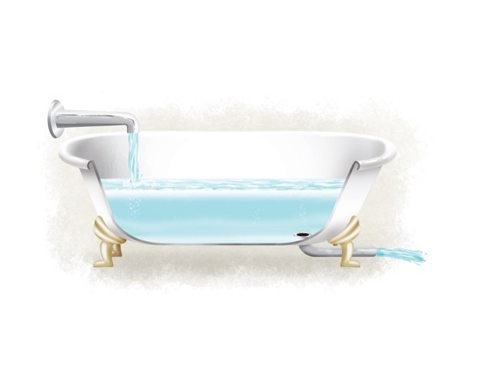

Stocks and Flows
Usually, we are interested in how much stock there is, e.g., the crop yield, soil organic matter content, nitrate load in streams, money in the bank.
What determines the amount in the stock?
Stock _{(t+1)} = Stock _{(t)} + Inputs - Outputs
Notes:
If Inputs = Outputs, there will be no change in the stock amount.

Slide 12

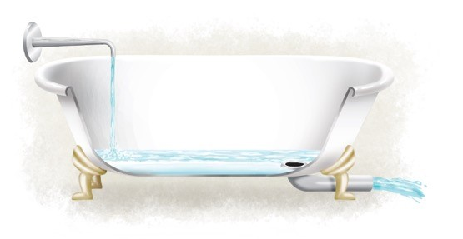

Stocks and Flows
What happens if inputs are greater than outputs?
If outputs are greater than inputs?
Notes:
Each drawing contains a: bath-tub, faucet of water flowing in (input arrow), a drain (hidden behind the bath-tub wall), a drainpipe (outflow) of water and a water level in the tub. (1) has equal inflows and outflow and a medium-sized drain and water level in the tub. (2) has a bigger inflow, smaller drain and outlflow, and higher water level in the tub. (3) has the opposite of (2.)

Slide 13
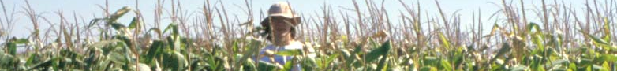
P6-Q
What is the Law of Conservation of Mass?
How does it apply to the nitrogen (N) cycle in Iowa agricultural systems?
Matter can be changed from one form into another, but the total mass in the universe remains constant. This means that within a farm, although N undergoes many reactions as it flows between the Atmosphere, Soil, Crops, and exports from the cropland as Yield and N to buffer strips and streams, the total N mass remains constant.

Slide 14
P6-A
What is the Law of Conservation of Mass?
Matter can be changed from one form into another, but the total mass in the universe remains constant. This means that within a farm, although N undergoes many reactions as it flows between the Atmosphere, Soil, Crops, and exports from the cropland as Yield and N to buffer strips and streams, the total N mass remains constant.

Slide 15
Nitrogen Budgets
The Law of Conservation of Mass allows us to construct N budgets for a farm.
We will use a simulation model to calculate for us the changes in N stocks within a farm, and its exports off-site.

Slide 16
Using a Simulation Model: Next 2 classes
We will use a simulation model to explore the Law of Conservation of Mass and to address ‘What-If’ questions by designing scenarios about different cropping systems and management practices.
  Individual Activity_N Model for IA Ag
Game: Play with model from the perspective of producers with four different goals. Determine which model settings are needed for the four Scenarios:
  Maximize Income
  Maximize soil conservation (Soil Organic N stocks)
  Minimize hypoxia in the Gulf of Mexico (N loss to streams) (see next slides)
  Optimize the 3 above goals in one management plan
Notes:
In financial terms, the goal would be to maximize revenue, the value of the output from the field minus the value of resources put into the field.

Slide 17
Why would a producer want to manage their Soil Organic Matter?
Can’t they simply add more fertilizer if the soil becomes degraded?
Sometimes, pictures are worth a thousand words.

Slide 18
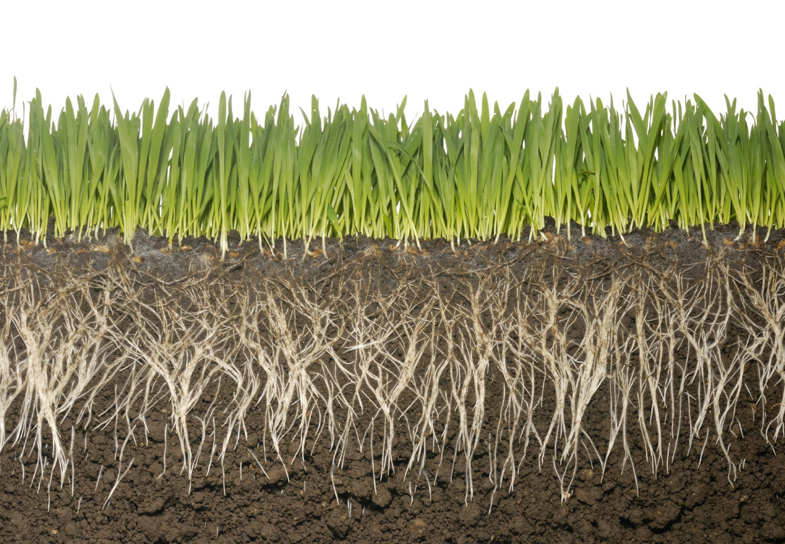
Cover Crop: Healthy soil
Notice the granular soil structure of a system with a cover crop.
This promotes water infiltration and water-holding capacity.
Soils with a lower bulk density can hold more water and nutrients, and crop roots can grow better and take up nutrients more easily.

Slide 19
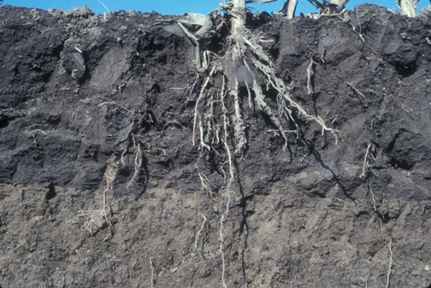
In comparison with:
Soil degraded by agriculture
Soil is very compacted, lacks granular structure
Less pore space = less space for water/air in soil
Jon Sandor

Slide 20
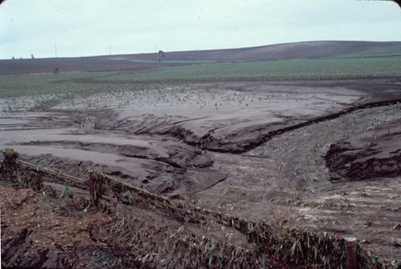
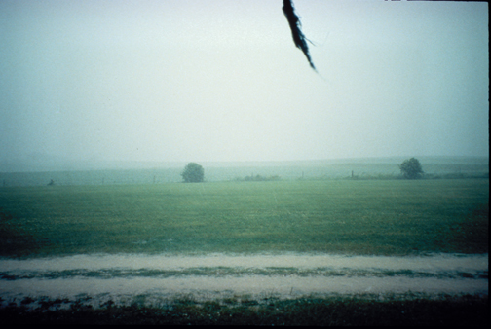
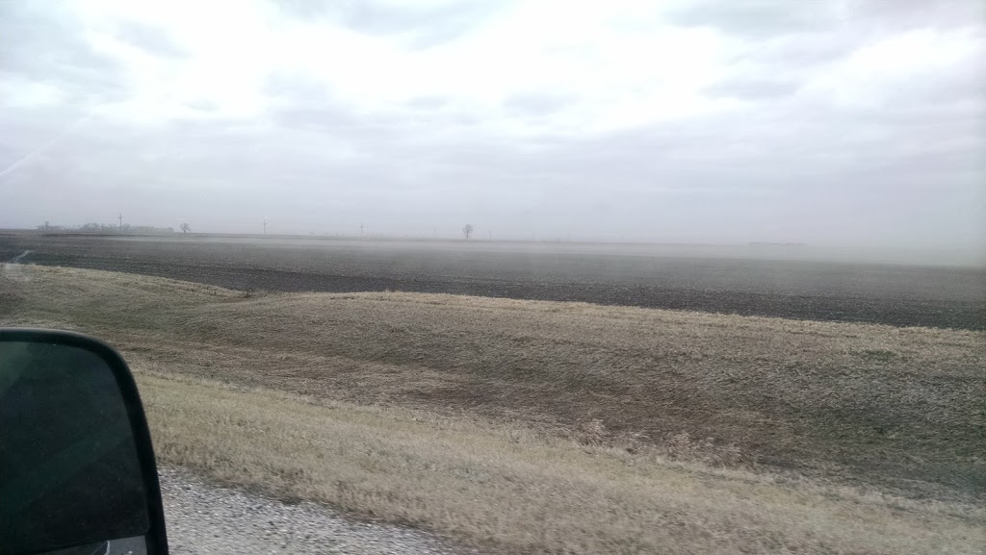
Case Studies: Effects of intensive agriculture on Midwest soils
Water erosion, southwest Iowa
Photo: David Hayes, near Atlantic, Iowa 1980
Wind erosion, Crookston, MN
Photo: Tyler Groh
Wind erosion, Iowa Erosion Surface
Photo: Lee Burras, 1995, near Grundy Center
Notes:
Without cover crops, there is little to no vegetation to hold soil in place between the time one crop is harvested and the next crop is planted, typically October through March or even April in Iowa. Thus, soil is vulnerable to wind and water erosion for 6 months when the soil is bare.

Slide 21
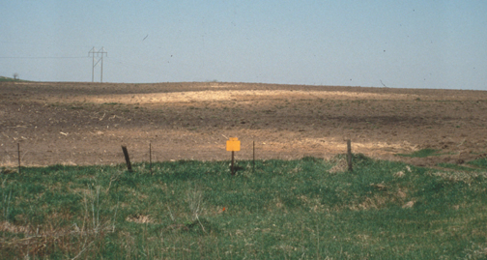
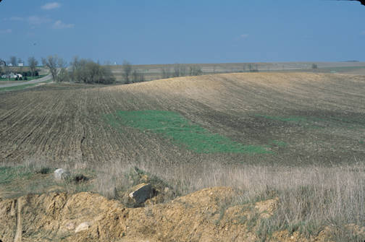
Effects of intensive agriculture on Midwest soils
Eroded Mollisols on agricultural land, Des Moines Lobe
Boone Co., Iowa
Photo: Mike Konen
southwest Minnesota
Photo: Jon Sandor
Note the lighter tan soil areas in these photos. This is where dark, nutrient-rich topsoil that was formed over the last 14,000 years, up to 1 meter in depth in some places, has been eroded, exposing the underlying rill.

Slide 22
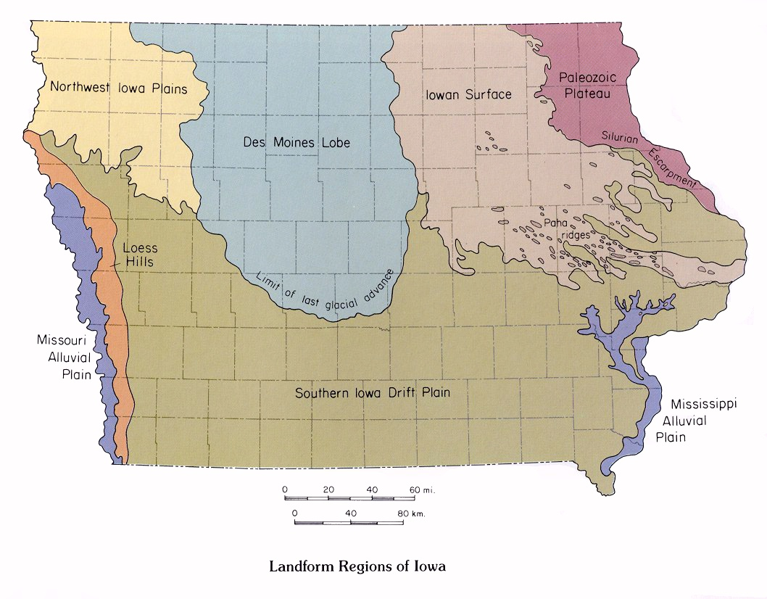
Notes:
The “Des Moines Lobe” was shaped by the Wisconsin-age ice sheet that moved clayrich shales and mudstones as the glacier moved southeasterly across the north central United States about 12,000 years ago. Most of this area is a nearly level to gently rolling till plain. Natural lakes dot this region and numerous bogs, swales and circular depressions indicate sites of previously ponded water. End moraines have a banded pattern across this area and are typically described as knob and kettle topography. These soils formed in loamy glacial till, glacial outwash, and/or local alluvium. The presettlement vegetation was primarily tallgrass prairie, with many islands of wet prairie (Kratz and Jensen 1983, Marschner, 1974). The soils are Mollisols (from Latin mollis, "soft"), the soils of grassland ecosystems. They are characterized by a thick, dark surface horizon. This fertile surface horizon, known as a mollic epipedon, results from the long-term addition of organic materials derived from plant roots. Mollisols are among some of the most important and productive agricultural soils in the world and are extensively used for this purpose.
The following information is based on the book Landforms of Iowa, by Jean C. Prior, published by the University of Iowa Press, Iowa City, in 1991. The book was designed and illustrated by Patricia J. Lohmann.”
USDA-NRCS:
https://www.nrcs.usda.gov/Internet/FSE_DOCUMENTS/nrcs142p2_006362.pdf

Slide 23
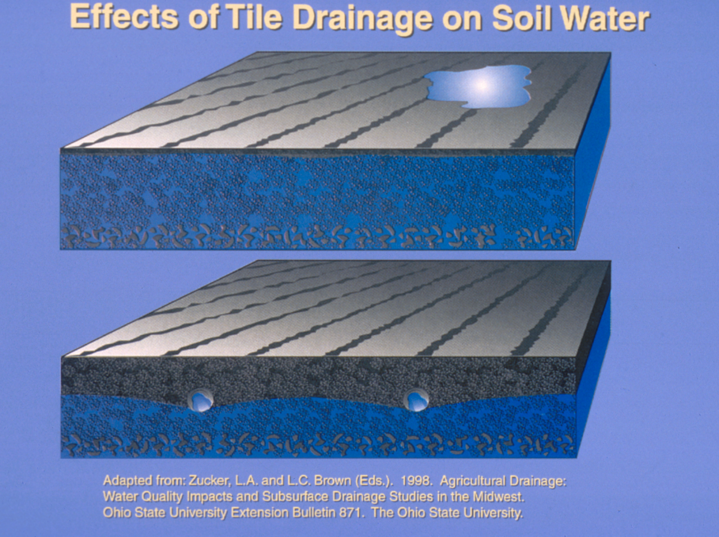
Notes:
Much of the area is naturally poorly drained, so tile drains have been installed in field to drain the soil so that agriculture can be practiced.

Slide 24
Why would a producer care about the effects of overuse of N fertilizer?
Hint: The effects are both local and regional.

Slide 25
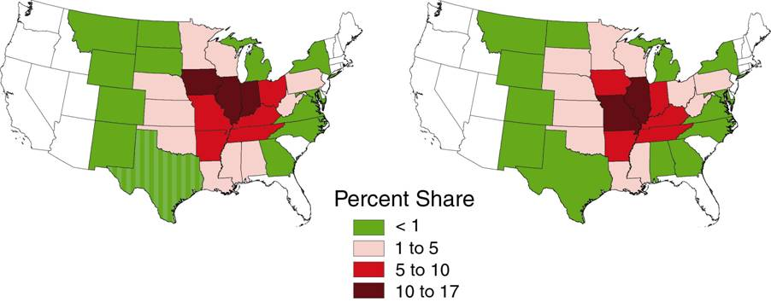
Nutrient delivery to the Gulf of Mexico
State shares of the total nutrient flux
Nitrogen
Phosphorus
Notes:
Iowa, Illinois and Indiana deliver the largest share of N and P to the Gulf of Mexico

Slide 26
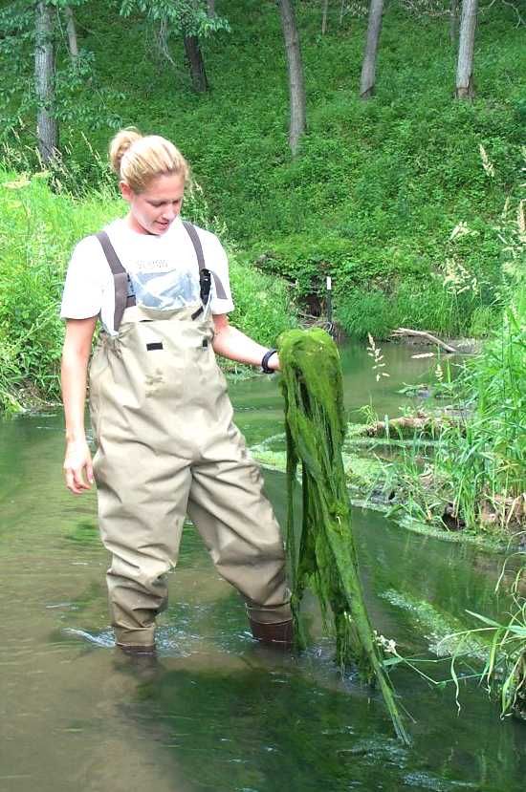
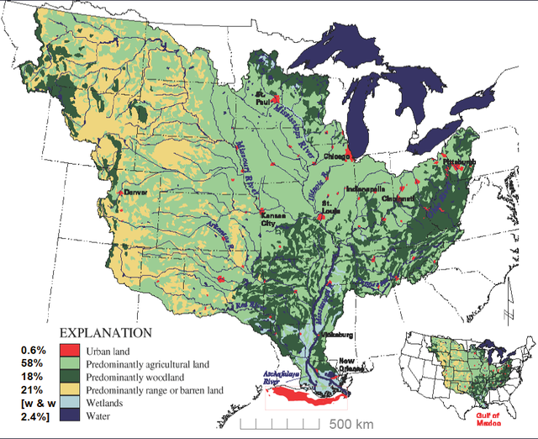
Nutrients – Downstream Flux vs. Local Stream Metabolism
Springbrook Cr. – Guthrie County
Areal extent of hypoxia determined by nutrient flux (discharge x concentration) during spring
Iowa DNR
Production/respiration rates determined by nutrient concentration during mid-late summer
Notes:
Large deliveries and N and P from industrial agriculture in the Midwest contribute to eutrophication of local streams, and downstream, all the way to the Gulf of Mexico.

Slide 27
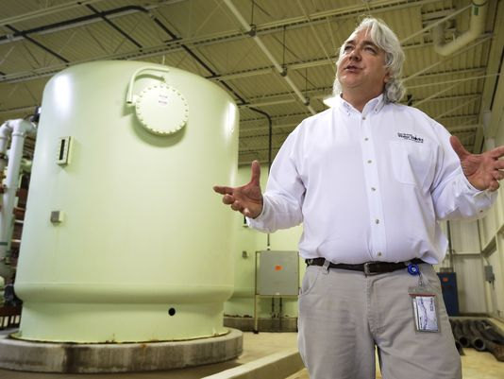
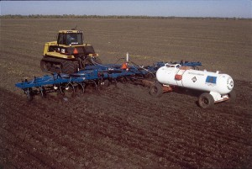
Nitrate Levels Hit Record Highs in Two Des Moines Rivers
Nitrate levels at record highs in the Des Moines and Raccoon rivers have forced the Des Moines Water Works to again use its nitrate removal facility. High nitrate levels "have required extraordinary efforts," the agency said. "Use of the nitrate removal facility is the last step available to maintain safe drinking water."
Higher concentrations of nitrates are more common in the spring, when excessive rain washes unused fertilizer from farm fields into streams. The federal limit is 10 milligrams per liter nitrate in drinking water. Current nitrate levels in the Raccoon River are 12.62 milligrams per liter, the agency said, and 11.63 milligrams per liter in the Des Moines River. With extensive treatment, the city's finished drinking water currently has a nitrate level of 8.79 milligrams per liter, the agency said.
"It is most likely that the wetter, milder temperatures this fall have contributed to the unusual movement of nitrate in the Raccoon and Des Moines rivers from a variety of sources," Rick Robinson of the Iowa Farm Bureau said. "Most reports from agronomists and co-ops are that only 25-50 percent of planned fall fertilizer was applied."

Slide 28
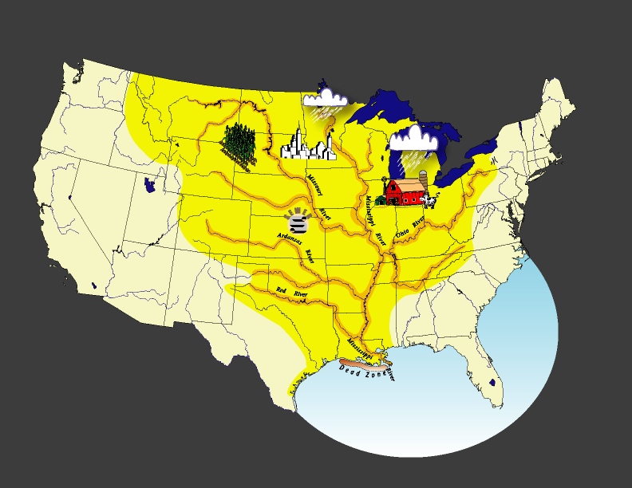
Notes:
Areal extent of the Mississippi River drainage

Slide 29
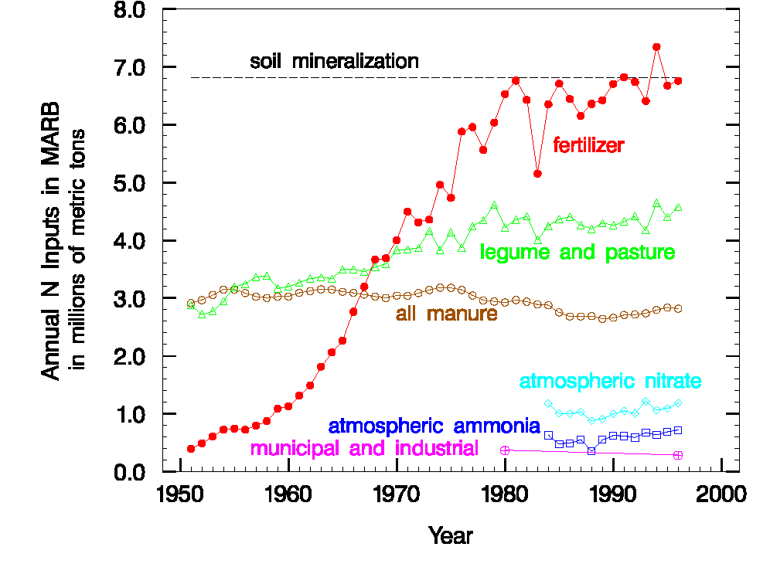
Nitrogen Balance – Mississippi Basin Inputs
Goolsby, et al
Notes:
Here are the N inputs to the base since 1950.
Largest change is fertilizer input.
Soil mineralization is comparable (not sure of time course)
Legumes/pasture and manure inputs are next
Rest are low - NOTE atmospheric is relatively low (unlike East Coast) and Point is trivial

Slide 30
http://www.noaa.gov/media-release/average-dead-zone-for-gulf-of-mexico-predicted
https://www.youtube.com/watch?v=rK_mEHqx7rw

Slide 31
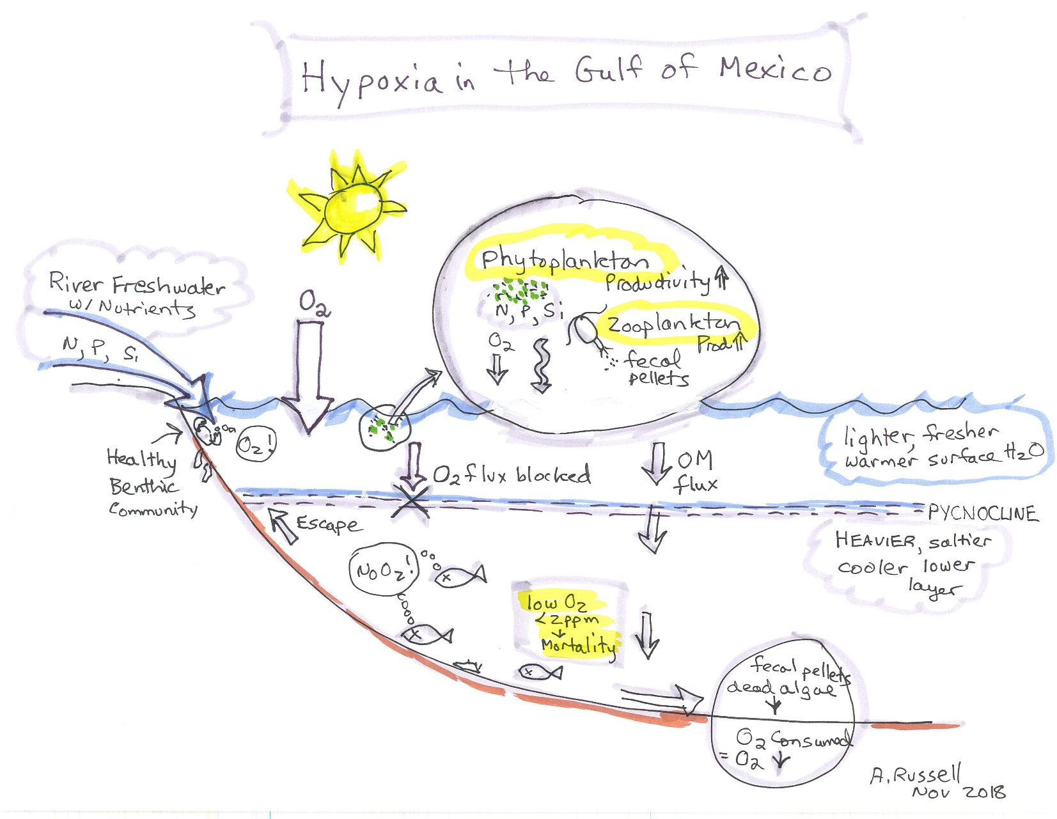
Sketch the mechanisms by which hypoxia is thought to occur within the Gulf of Mexico.
2 pts
Notes:
Note: We do this either together as a class, with the instructor leading the drawing on an Elmo, or students draw individually and then share their diagrams on the Elmo.

Slide 32
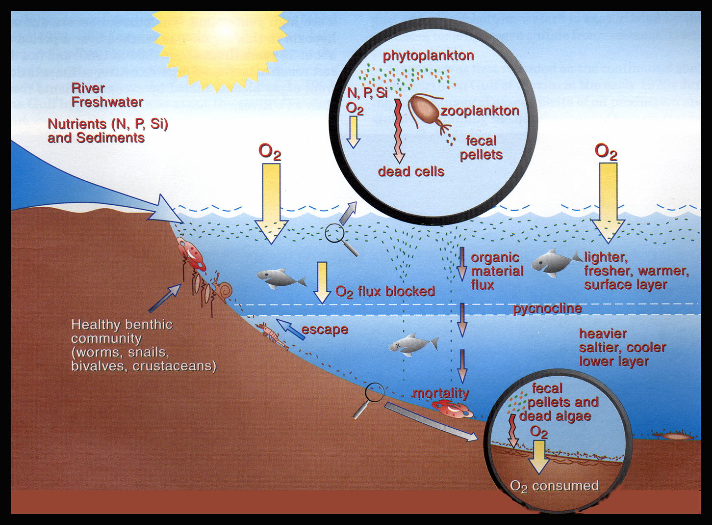
Notes:
The Gulf of Mexico (marine system) historically N limited, so N inputs from Mississippi stimulate production. Chemically stratified, colder, denser saline water at bottom; freshwater on top in summer. Algal growth in upper water column, they die, go down to bottom or eaten by zooplankton, poop goes downward also. Huge productivity goes down to sea floor Mobile critters move out. Only happens during the middle of summer when there is strong stratification: pycnocline is a layer in an ocean in which water density increases rapidly with depth; aerobic respiration on seafloor, consumes O2. Lack of mixing blocks O2 above pycnocline from replenishing O2 supply below. Hypoxia occurs at <2 ppm O2

Slide 33
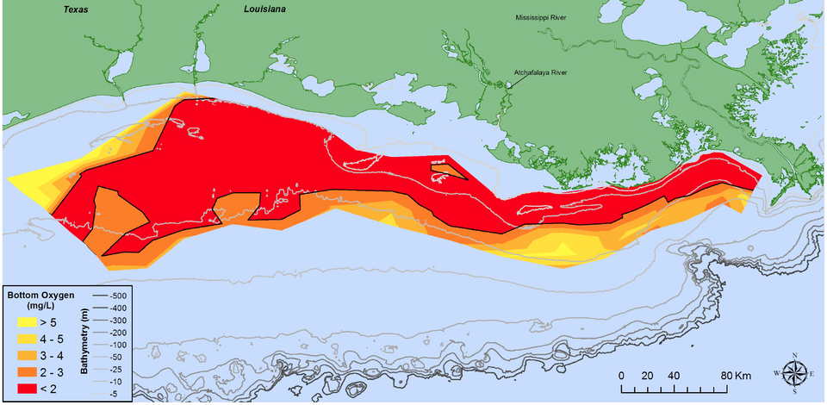
Extent of Hypoxia in the Gulf
Predicted for 2018: ~the size of Connecticut

Slide 34
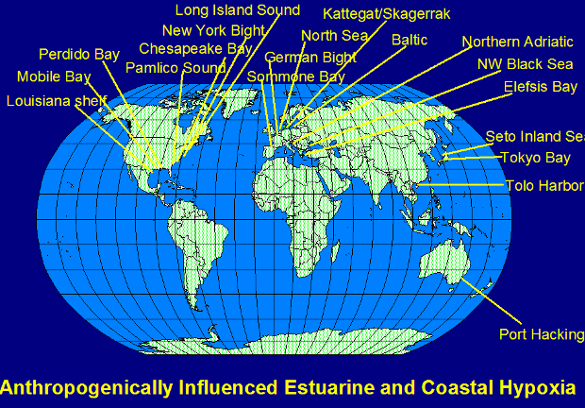
Notes:
The same conditions that lead to hypoxia in the Gulf of Mexico occur elsewhere. Note all the other locations where it has been documented.

Slide 35
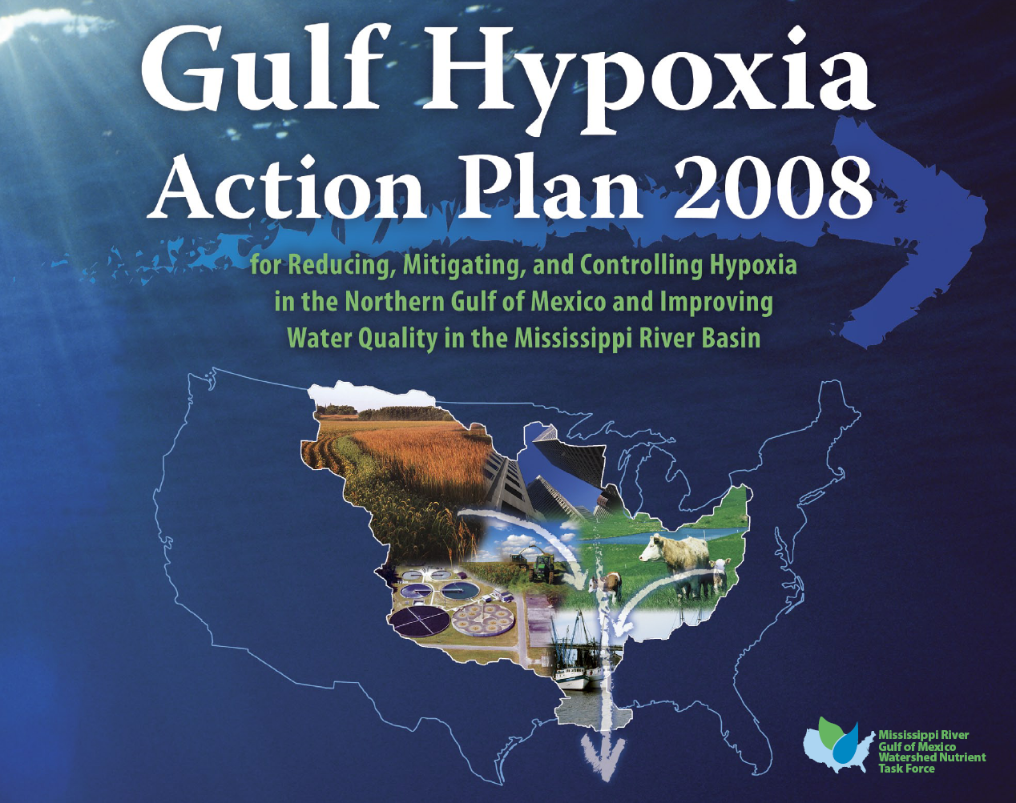
For more information, visit the Gulf Hypoxia website:
https://www.epa.gov/ms-htf

Slide 36
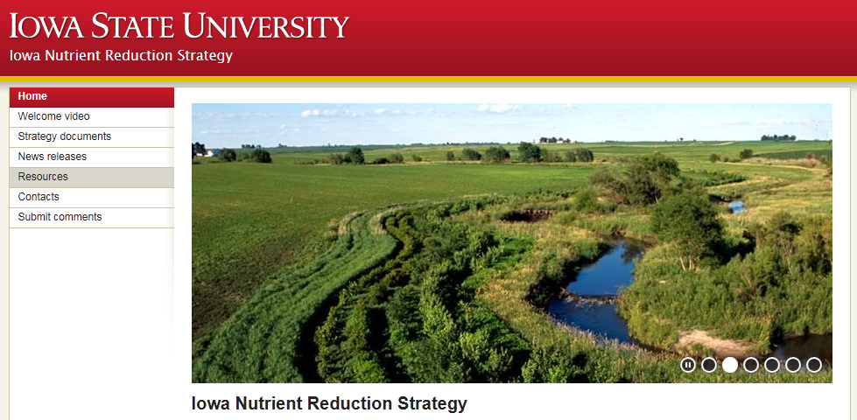
Visit the Iowa Nutrient Reduction Strategy website
www.nutrientstrategy.iastate.edu

